Slide 2
Now a virtual conference
Two-day format
Main event on Saturday
DNA Primer on Friday
100% live speakers
Multiple tracks
Later viewing of all sessions
GeneaUs Bar returns
Virtual lunch tables
And a cast of internationally, nationally, and regionally known speakers…
What’s
new
this
year?

Slide 3
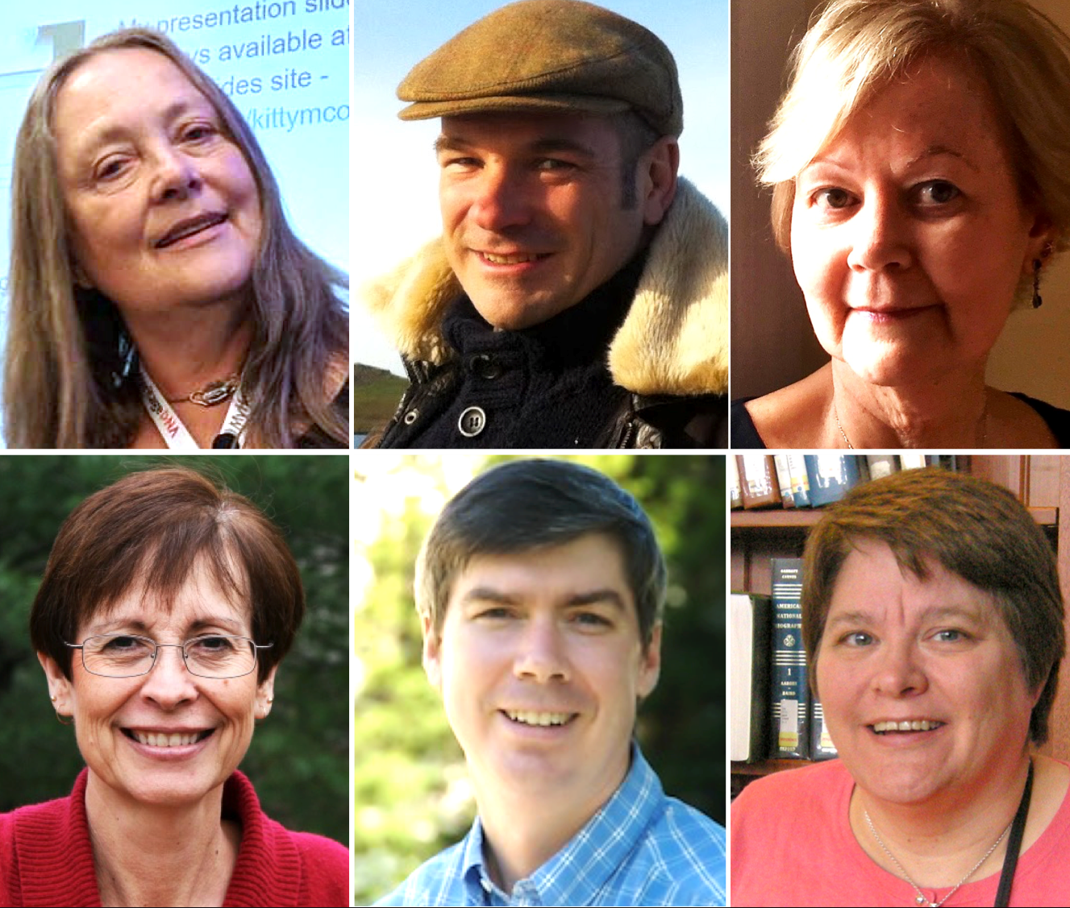
Featuring:
Kitty Cooper
Maurice Gleeson
Gail Lukasik
Jane Haldeman
Dan Hubbard
Michelle Wilson

Slide 4
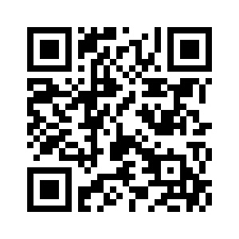
More information
Registration:
https://caggni.org/GeneaQuest-2020
Facebook:
https://www.facebook.com/GeneaQuest

